Slide 1
The Family Issue in the
Middle East

Slide 2
The Issue
The family issue in the Middle East is a very important one, because many families are struggling because of the conflicts that are happening throughout the region.
The families are having a tough time trying to survive, and just get the basic essentials to live their lives.

Slide 3
The Issue in the Middle East
The issue of families in the Middle East is very important because of all of the conflicts that have been happening lately in the region. Many families are affected by the fighting and are struggling to stay alive. These families seek help from the United Nations. Many of them struggle to have a job, have enough food, and have a hard time supporting their families.

Slide 4
Impact of the UN on the Middle East
The United Nations has been working with the issue of Palestine since 1947 and continues investigate the issue
The UN is working on Israeli-Palestinian peace and hopes to resolve the issues between them
The United Nations hopes to improve the lives of families struggling in the Middle East and to help them get back on their feet.

Slide 5
The Future of the Issue
There are some support groups of the families in the Middle East that are trying to set up refugee camps and that are trying to help these struggling families out. Many groups are trying to lay the groundwork for secure societies. Families want to be insured of a safe community, good education for the children, and an overall better future.

Slide 6
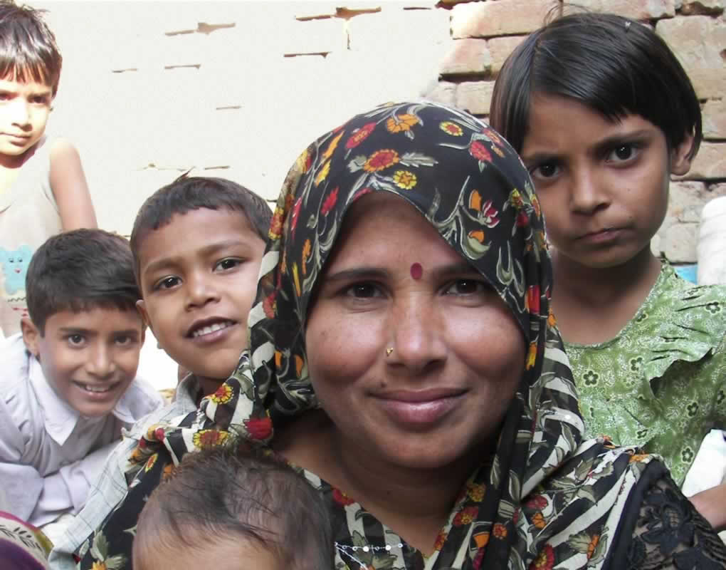

Slide 7
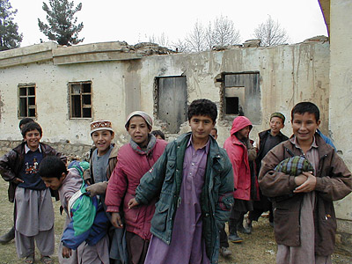

Slide 8
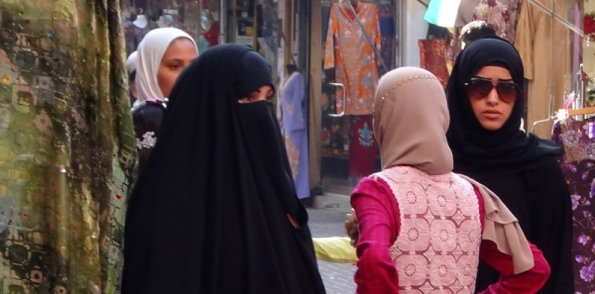

Slide 9
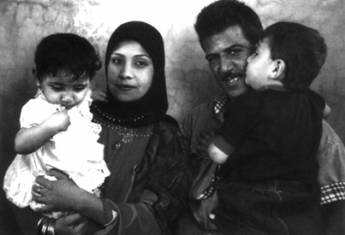

Slide 10
