Slide 1
Current Events
Middle East

Slide 2
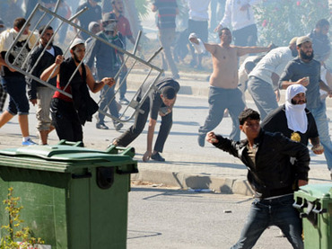
Tunisia
In September 2012, demonstrators stormed the American embassy in Tunisia. The American Cooperative school across the street was burned and completely destroyed.

Slide 3
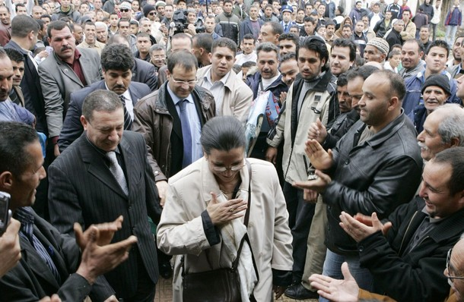
Algeria
There have been a number of Algerian protests in the last few years which have led to travel concerns for Americans because these protests pose a big terrorist threat to Americans traveling to Algeria.

Slide 4
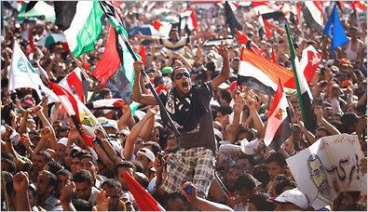
Egypt
A revolution between the government and the Islamist group in Egypt began in June 2012. Then, in September, there was an outrage over a film published on YouTube about anti-Islamic topics that led to the attack of the United States embassy in Cairo.

Slide 5
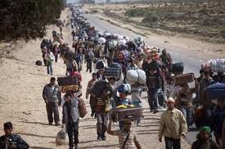
Libya
The Libyan Civil war is currently taking place between the pro-government people and the anti-government forces. This war began in February of 2011 and the rebellion has spread across the country.

Slide 6
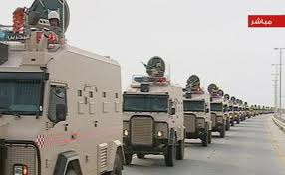
Saudi Arabia
A series of minor protests have been held in Saudi Arabia’s oil-rich Eastern Province, where the Shia’s population resides. The state has reminded the country of the protest ban currently in Saudi Arabia

Slide 7
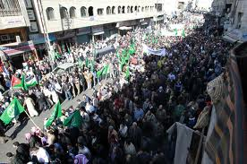
Jordan
Jordan is also involved with the protests of the Arab world. There have been protests about high unemployment, food prices, and political corruption. The anger is aimed at the parliament and the bureaucracy.

Slide 8
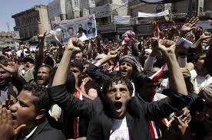
Yemen
Yemen has been in turmoil since January 2011 when protestors took the streets in violent attacks against the rule of President Saleh. There have been hundreds of deaths and much rising chaos.

Slide 9
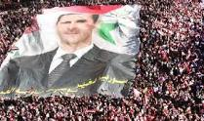
Syria
The Syrian civil war is currently taking place between forces loyal to the government and those seeking to overthrow it. The conflict began in March 2011 and has involved the movement known as the Arab Spring.

